Slide 1
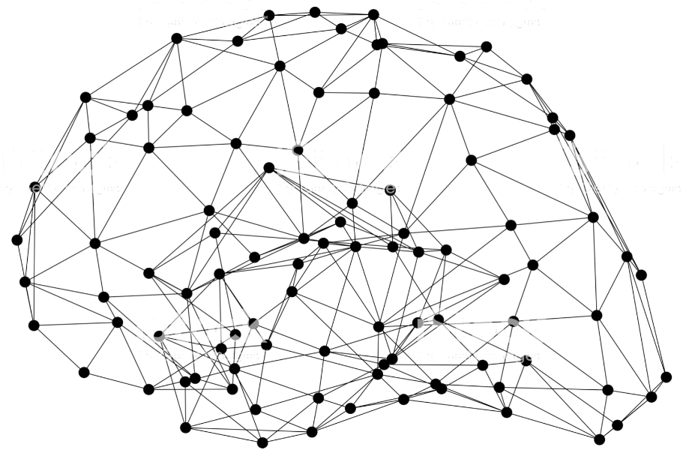

ICCV 2019 Tutorial: Everything You Need to Know to Reproduce SOTA Deep Learning Models
Presenter: Zhi Zhang, Sam Skalicky, Muhyun Kim, Jiyang Kang
Notes:
Thank you for attending our half day tutorial of everything you need to know to reproduce State of the art deep learning models. In this tutorial we will try to cover every tiny bits of the reproduction, from the underlying deep learning framework, to various computer vision tasks, datasets and algorithms, and most importantly, some tricks to adopt as well as some pitfalls to avoid, so you can reproduce the result at home smoothly.

Slide 2
Agenda
Time | Contents
8:00-8:15 | Welcome and AWS Setup(Free instance available)
8:15-8:40 | Introduction to GluonCV and MXNet
8:40-9:00 | Deep Learning and Gluon Basics (NDArray, AutoGrad, Libraries)
9:00-9:30 | Bag of Tricks for Image Classification (ResNet, MobileNet, Inception)
9:30-10:00 | Bag of Freebies for Object Detectors (SSD, Faster RCNN, YOLOV3)
10:00-10:30 | Semantic segmentation algorithms (FCN, PSPNet, DeepLabV3, VPLR)
10:30-11:00 | Pose Estimation(SimplePose, AlphaPose)
11:00-11:30 | Action Recognition(TSN, I3D)
11:30-12:00 | Painless Deployment (C++, TVM)
12:00-12:15 | Q&A and Closing
Notes:
Please check out the agenda listed. This is going to be tight for the amount of contents but always feel free to interrupt us if you have any questions.

Slide 3
Free AWS SageMaker instance
iccv19-gluoncv@request-nb.mxnet.io
Notes:
Please send an email to this email account and shortly we will reply two emails, one for confirmation, and the second email will include a unique url for you to try the runnable examples. I strongly recommend you to try it now, since it will take a while to download some large datasets we will use for today.

Slide 4
The cool stuffs you will get today:
Know what tasks and models you can grab from GluonCV directly
Peek models and training strategies that you can apply to get SOTA results
Learn some implementation details through hands on notebooks
Embrace the ecosystem that is designed to ease computer vision
Notes:
Today’s tutorial won’t sufficiently cover all the contents available in GluonCV, but I hope you guys can learn…

